Slide 1
Chapter 13
Control Structures

Slide 2
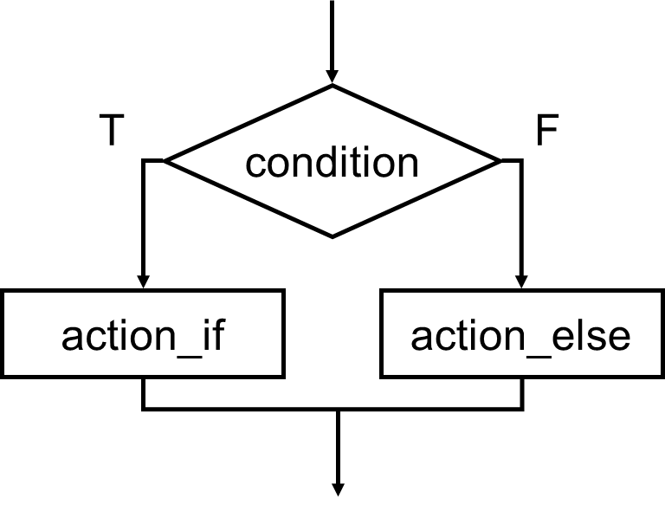
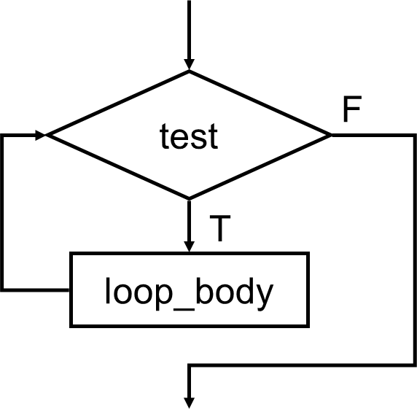
Highlights
Sequence
Conditional
Iteration
action_1
action_2
13-<number>

Slide 3
Control Structures
Conditional
  making a decision about which code to execute,
  based on evaluated expression
  if
  if-else
  switch
Iteration
  executing code multiple times,
  ending based on evaluated expression
  while
  for
  do-while
13-<number>

Slide 4
If
if (condition)
action;
condition
F
T
action
Condition is a C expression,
which evaluates to TRUE (non-zero) or FALSE (zero).
Action is a C statement,
which may be simple or compound (a block).
13-<number>

Slide 5
Example If Statements
if (x <= 10)
y = x * x + 5;
if (x <= 10) {
y = x * x + 5;
z = (2 * y) / 3;
}
if (x <= 10)
y = x * x + 5;
z = (2 * y) / 3;
compound statement;
both executed if x <= 10
(you now know why compound
statements are needed)
only first statement is conditional;
second statement is
always executed
13-<number>

Slide 6
More If Examples
if (0 <= age && age <= 11)
kids += 1;
if (month == 4 || month == 6 ||
month == 9 || month == 11)
printf(“The month has 30 days.\n”);
if (x = 2)
y = 5;
This is a common programming error (= instead of ==),
not caught by compiler because it’s syntactically correct.
always true,
so action is always executed!
13-<number>

Slide 7
If’s Can Be Nested
if (x == 3)
if (y != 6) {
z = z + 1;
w = w + 2;
}
is the same as...
if ((x == 3) && (y != 6)) {
z = z + 1;
w = w + 2;
}
13-<number>

Slide 8
Generating Code for If Statement
; if (x == 2) y = 5;
LDR R0, R5, #0 ; load x into R0
ADD R0, R0, #-2 ; subtract 2
BRnp NOT_TRUE ; if non-zero, x is not 2
AND R1, R1, #0 ; store 5 to y
ADD R1, R1, #5
STR R1, R5, #-1
NOT_TRUE ... ; next statement
13-<number>

Slide 9
If-else
if (condition)
action_if;
else
action_else;
T
condition
F
action_if
action_else
Else allows choice between
two mutually exclusive actions without re-testing condition.
13-<number>

Slide 10
Generating Code for If-Else
if (x) {
y++;
z--;
}
else {
y--;
z++;
}
LDR R0, R5, #0
BRz ELSE
; x is not zero
LDR R1, R5, #-1 ; incr y
ADD R1, R1, #1
STR R1, R5, #-1
LDR R1, R5, #-2 ; decr z
ADD R1, R1, #-1
STR R1, R5, #-2
BR DONE ; skip else code
; x is zero
ELSE LDR R1, R5, #-1 ; decr y
ADD R1, R1, #-1
STR R1, R5, #-1
LDR R1, R5, #-2 ; incr z
ADD R1, R1, #1
STR R1, R5, #-2
DONE ... ; next statement
13-<number>

Slide 11
Matching Else with If (ambiguity resolution)
Else is always associated with closest unassociated if.
if (x != 10)
if (y > 3)
z = z / 2;
else
z = z * 2;
is the same as...
is NOT the same as...
if (x != 10) {
if (y > 3)
z = z / 2;
else
z = z * 2;
}
if (x != 10) {
if (y > 3)
z = z / 2;
}
else
z = z * 2;
13-<number>

Slide 12
Chaining If’s and Else’s
if (month == 4 || month == 6 || month == 9 ||
month == 11)
printf(“Month has 30 days.\n”);
else if (month == 1 || month == 3 ||
month == 5 || month == 7 ||
month == 8 || month == 10 ||
month == 12)
printf(“Month has 31 days.\n”);
else if (month == 2)
printf(“Month has 28 or 29 days.\n”);
else
printf(“Don’t know that month.\n”);
13-<number>

Slide 13
While
while (test)
loop_body;
test
F
T
loop_body
Executes loop body as long as
test evaluates to TRUE (non-zero).
Note: Test is evaluated before executing loop body.
13-<number>

Slide 14
Generating Code for While
x = 0;
while (x < 10) {
printf(“%d ”, x);
x = x + 1;
}
AND R0, R0, #0
STR R0, R5, #0 ; x = 0
; test
LOOP LDR R0, R5, #0 ; load x
ADD R0, R0, #-10
BRzp DONE
; loop body
LDR R0, R5, #0 ; load x
...
<printf>
...
ADD R0, R0, #1 ; incr x
STR R0, R5, #0
JMP LOOP ; test again
DONE ; next statement
13-<number>

Slide 15
Infinite Loops
The following loop will never terminate:
x = 0;
while (x < 10)
printf(“%d ”, x);
Loop body does not change condition,
so test never fails.
This is a common programming error
that can be difficult to find.
13-<number>

Slide 16
For
for (init; end-test; re-init)
statement
init
F
test
T
loop_body
Executes loop body as long as
test evaluates to TRUE (non-zero).
Initialization and re-initialization
code included in loop statement.
Note: Test is evaluated before executing loop body.
re-init
13-<number>

Slide 17
Generating Code for For
for (i = 0; i < 10; i++)
printf(“%d ”, i);
; init
AND R0, R0, #0
STR R0, R5, #0 ; i = 0
; test
LOOP LDR R0, R5, #0 ; load i
ADD R0, R0, #-10
BRzp DONE
; loop body
LDR R0, R5, #0 ; load i
...
<printf>
...
; re-init
ADD R0, R0, #1 ; incr i
STR R0, R5, #0
JMP LOOP ; test again
DONE ; next statement
This is the same
as the while example!
13-<number>

Slide 18
Example For Loops
/* -- what is the output of this loop? -- */
for (i = 0; i <= 10; i ++)
printf("%d ", i);
/* -- what does this one output? -- */
letter = 'a';
for (c = 0; c < 26; c++)
printf("%c ", letter+c);
/* -- what does this loop do? -- */
numberOfOnes = 0;
for (bitNum = 0; bitNum < 16; bitNum++) {
if (inputValue & (1 << bitNum))
numberOfOnes++;
}
13-<number>

Slide 19
Nested Loops
Loop body can (of course) be another loop.
/* print a multiplication table */
for (mp1 = 0; mp1 < 10; mp1++) {
for (mp2 = 0; mp2 < 10; mp2++) {
printf(“%d\t”, mp1*mp2);
}
printf(“\n”);
}
Braces aren’t necessary,
but they make the code easier to read.
13-<number>

Slide 20
Another Nested Loop
The test for the inner loop depends on the
counter variable of the outer loop.
for (outer = 1; outer <= input; outer++) {
for (inner = 0; inner < outer; inner++) {
sum += inner;
}
}
13-<number>

Slide 21
For vs. While
In general:
For loop is preferred for counter-based loops.
  Explicit counter variable
  Easy to see how counter is modified each loop
While loop is preferred for sentinel-based loops.
  Test checks for sentinel value.
Either kind of loop can be expressed as the other,
so it’s really a matter of style and readability.
13-<number>

Slide 22
Do-While
do
loop_body;
while (test);
loop_body
test
T
F
Executes loop body as long as
test evaluates to TRUE (non-zero).
Note: Test is evaluated after executing loop body, so the loop
is executed at least once.
13-<number>

Slide 23
Problem Solving in C
Stepwise Refinement
  as covered in Chapter 6
...but can stop refining at a higher level of abstraction.
Same basic constructs
  Sequential -- C statements
  Conditional – if, if-else, switch
  Iterative -- while, for, do-while
13-<number>

Slide 24
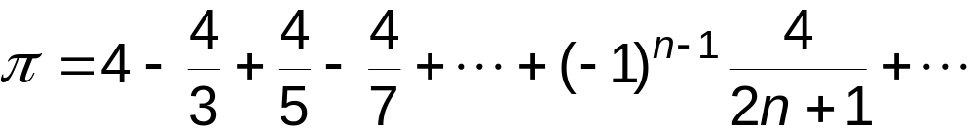
Problem 1: Calculating Pi
Calculate π using its series expansion.
User inputs number of terms.
Start
Evaluate
Series
Initialize
Output
Results
Get Input
Stop
13-<number>

Slide 25
Pi: 1st refinement
Start
Initialize
iteration count
Initialize
for loop
count<terms
F
Get Input
T
Evaluate
Series
Evaluate
next term
Output
Results
count = count+1
Stop
13-<number>

Slide 26
Pi: 2nd refinement
Initialize
iteration count
count
is odd
count<terms
T
F
F
T
Evaluate
next term
subtract new term
add new term
count = count+1
if-else
13-<number>

Slide 27
Pi: Code for Evaluate Terms
…
double pi = 0.0;
…
for (count=1; count <= numOfTerms; count++) {
if (count % 2) {
/* odd term */
pi = pi + (4.0 / (2.0 * count - 1));
}
else {
/* even term */
pi = pi – (4.0 / (2.0 * count - 1));
}
13-<number>

Slide 28
Pi: Complete Code
#include <stdio.h>
main() {
double pi = 0.0;
int numOfTerms, count;
printf("Number of terms (must be 1 or larger) : ");
scanf("%d", &numOfTerms);
for (count=1; count <= numOfTerms; count++) {
if (count % 2) {
/* odd term */
pi = pi + (4.0 / (2.0 * count - 1));
}
else {
/* even term */
pi = pi – (4.0 / (2.0 * count - 1));
}
printf("The approximate value of pi is %f\n", pi);
}
13-<number>

Slide 29
Problem 2: Finding Prime Numbers
Print all prime numbers less than 100.
  A number is prime if its only divisors are 1 and itself.
  All non-prime numbers less than 100 will have a divisor
  between 2 and 10.
Start
Initialize
Print primes
Stop
13-<number>

Slide 30
Primes: 1st refinement
Initialize
num = 2
Start
num < 100
F
Initialize
T
Print primes
Print num
if prime
Stop
num = num + 1
13-<number>

Slide 31
Primes: 2nd refinement
Initialize
num = 2
Divide num by
2 through 10
num < 100
F
no
divisors?
F
T
Print num
if prime
T
Print num
num = num + 1
13-<number>

Slide 32
Primes: 3rd refinement
Initialize
divisor = 2
set flag to TRUE
Divide num by
2 through 10
divisor <= 10
F
no
divisors?
F
T
set flag to FALSE if
(num%divisor == 0) &&
(num != divisor)
T
Print num
divisor =
divisor + 1
13-<number>

Slide 33
Primes: Using a Flag Variable
To keep track of whether number was divisible,
we use a "flag" variable.
  Set prime = TRUE, assuming that this number is prime.
  If any divisor divides the number and the divisor is not the number itself,
  set prime = FALSE.
    Once it is set to FALSE, it stays FALSE.
  After all divisors are checked, number is prime if
  the flag variable is still TRUE.
Use macros to help readability.
#define TRUE 1
#define FALSE 0
13-<number>

Slide 34
Primes: Complete Code
#include <stdio.h>
#define TRUE 1
#define FALSE 0
main () {
int num, divisor, prime;
/* start with 2 and go up to 100 */
for (num = 2; num < 100; num ++ ) {
prime = TRUE; /* assume num is prime */
/* test whether divisible by 2 through 10 */
for (divisor = 2; divisor <= 10; divisor++)
if (((num % divisor) == 0) && (num != divisor))
prime = FALSE; /* not prime */
if (prime) /* if prime, print it */
printf("The number %d is prime\n", num);
}
}
Optimization: Could put
a break here to avoid some work.
(Section 13.5.2)
13-<number>

Slide 35
Switch
evaluate
expression
switch (expression) {
case const1:
action1; break;
case const2:
action2; break;
default:
action3;
}
= const1?
action1
T
F
= const2?
action2
T
Disciplined use of
switch statement
F
action3
Alternative to long if-else chain.
If break is not used, then
case "falls through" to the next.
13-<number>

Slide 36
Switch Example
/* same as month example for if-else */
switch (month) {
case 4:
case 6:
case 9:
case 11:
printf(“Month has 30 days.\n”);
break;
case 1:
case 3:
/* some cases omitted for brevity...*/
printf(“Month has 31 days.\n”);
break;
case 2:
printf(“Month has 28 or 29 days.\n”);
break;
default:
printf(“Don’t know that month.\n”);
}
13-<number>

Slide 37
More About Switch
Case expressions must be constant.
case i: /* illegal if i is a variable */
If no break, then next case is also executed. (Not a good practice)
switch (a) {
case 1:
printf(“A”);
case 2:
printf(“B”);
default:
printf(“C”);
}
If a is 1, prints “ABC”.
If a is 2, prints “BC”.
Otherwise, prints “C”.
13-<number>

Slide 38
Break and Continue
break;
  used only in switch statement or iteration statement
  passes control out of the “smallest” (loop or switch) statement containing it to the statement immediately following
  usually used to exit a loop before terminating condition occurs
  (or to exit switch statement when case is done)
continue;
  used only in iteration statement
  terminates the execution of the loop body for this iteration
  loop expression is evaluated to see whether another
  iteration should be performed
  if for loop, also executes the re-initializer
13-<number>

Slide 39
Example
What does the following loop do?
for (i = 0; i <= 20; i++) {
if (i%2 == 0) continue;
printf("%d ", i);
}
What would be an easier way to write this?
What happens if break instead of continue?
13-<number>

Slide 40
꼭 기억해야 할 것
Control Structures
  sequence
  conditional (if-else)
  iterative (while loop)
Secondary Control Structures
  conditional
    if
    switch
  iterative
    for loop
    do-while loop
  miscellaneous
    continue
    break
11-<number>

